Slide 1

BEGINNERS’ LESSONS
Welcome
Teacher: Your Name Here
Telephone: 123 4567
Email: email@address.co.nz

Slide 2
Lesson Two
1-Level Opening Bids

Slide 3

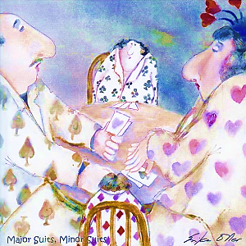
Ranking of the Suits
NoTrumps
Spades ♠
Hearts ♥
Diamonds ♦
Clubs ♣
Major suits
Minor suits
Notes:
Emphasise Major / NoTrumps / Minor ... Talk about this as often as possible

Slide 4

Finding a Fit
A Fit is 8+ cards in one suit
If there is a fit in a major this will be the trump suit
If there is no fit, then choose NoTrumps

Slide 5

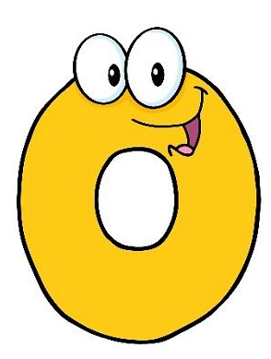
Levels of Bidding
The number of tricks you must make to get a
score = 6 + the level you bid
  1-level contracts ... Must make 7 tricks (6 + 1)
  2-level contracts ... Must make 8 tricks (6 + 2)
  3-level Contracts ... Must make tricks (6 + 3) etc
  4-level Contracts ... Must make tricks
  6-level Contracts ... Must make tricks

Slide 6
The Auction
Every suit has a ranking order
Each bid must be higher than the previous bid
1♣ | 1♦ | 1♥ | 1♠ | 1NT
2♣ | 2♦ | 2♥ | 2♠ | 2NT
3♣ | 3♦ | 3♥ | 3♠ | 3NT
4♣ | 4♦ | 4♥ | 4♠ | 4NT
etc
The first person to bid is the Opener
Opener’s partner is the Responder

Slide 7
Basic Rules for Opening 1-suit
You must have enough High Card Points
12-19

Slide 8
Basic Rules for Opening 1-suit
12-19
Q = 2
A = 4
K = 3
J = 1

Slide 9
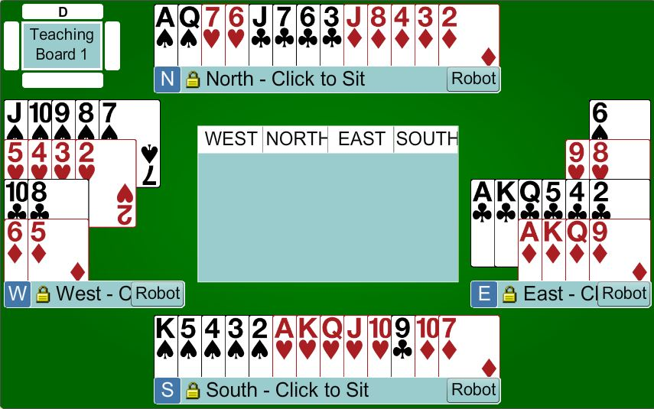
Which hand can open the bidding?
Board
1

Slide 10
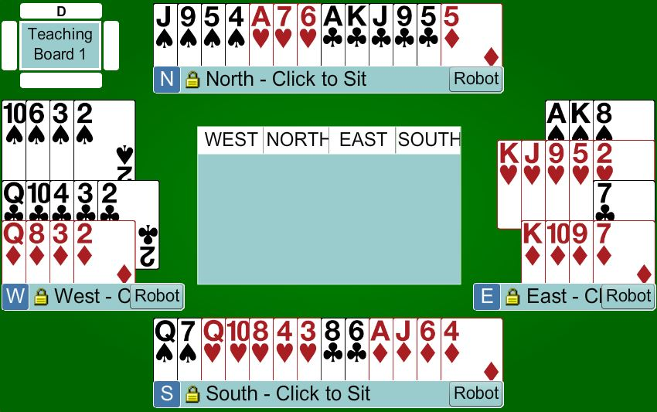
Which hand can open the bidding?
Board
2

Slide 11
Opener’s First Bid
 | Points | Description
1♣ | 12 - 19 | 4 + clubs
1♦ | 12 – 19 | 4 + diamonds
1♥ | 12 – 19 | 4 + hearts
1♠ | 12 – 19 | 4 + spades
1NT | 12 – 14 | Balanced hand ... SPECIAL CASE

Slide 12

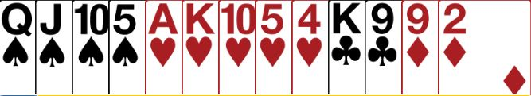
Rules for 1-level suit openings
Bid your longest suit first

Slide 13


Basic Rules for 1-level suit openings
Bid your lower ranking 4-card suit first

Slide 14
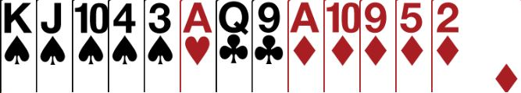

What do you open?
Bid your higher ranking 5-card suit first

Slide 15
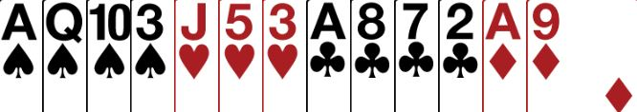
What do you open with this hand?
Open 1♣
… open your lower ranking 4-card suit first

Slide 16
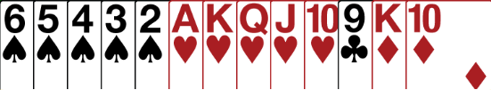
What do you open with this hand?
Open 1♠
… open your higher ranking 5-card suit first

Slide 17
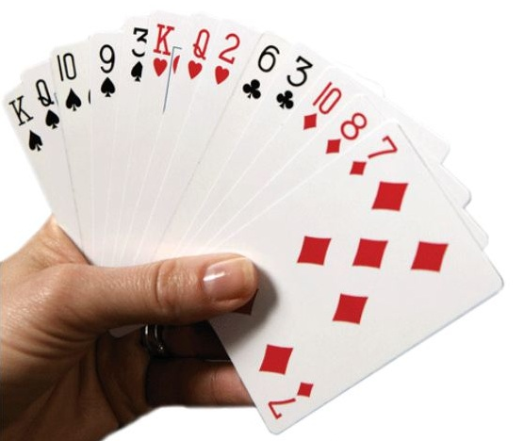
Further Bidding ... To come in more detail
Responder needs 6 + points to bid ... At least ½ of what Opener needs
Try to find a Fit as soon as possible
There are 3 choices of level to bid to:
  Minimum (6 – 9)
  Close to Game (10 – 12)
  Enough for Game (13+)
If there is NO fit, then bid NoTrumps
To bid Game you need 25+ points between the two hands

Slide 18

This is what a good bridge hand looks like
Notes:
Golden Bridge, Vietnam

Slide 19
Summary for 1-level suit openers
12-19
Open with 12-19 points
Bid your longest suit first
If you have two 4-card suits bid the lower ranked suit first
If you have two 5-card suits bid the higher ranked suit first
Suit quality does not matter

Slide 20
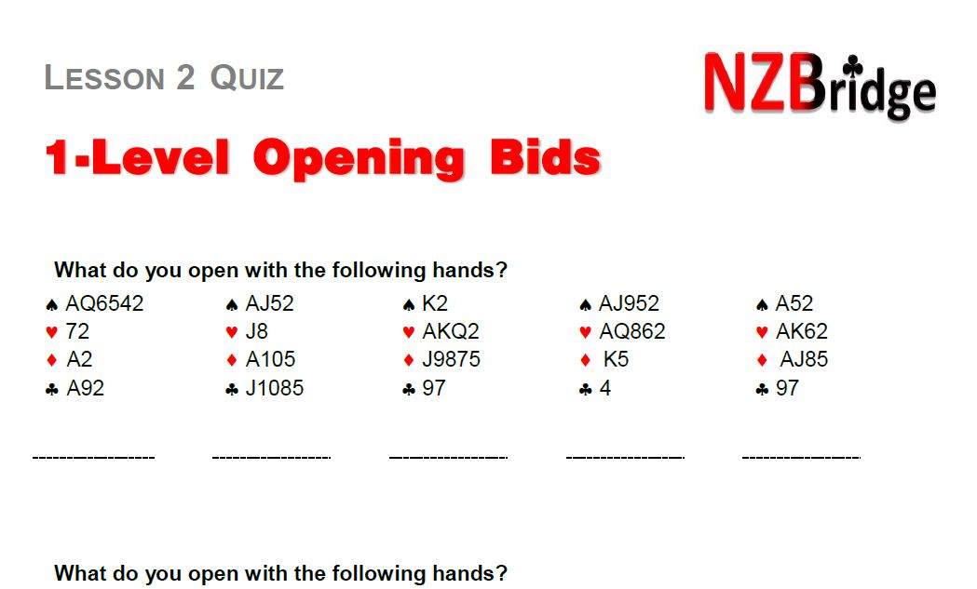
Homework

Slide 21
BEGINNERS’ LESSONS
any questions please ask
Teacher: your name
Telephone: your number
Email: your email

