Slide 1

BEGINNERS’ LESSONS
Welcome
Teacher: Your Name Here
Telephone: 123 4567
Email: email@address.co.nz

Slide 2
Lesson Five
Balanced Hands

Slide 3
Opener’s First Bid
 | Points | Description
1♣ | 12 - 19 | 4 + clubs
1♦ | 12 – 19 | 4 + diamonds
1♥ | 12 – 19 | 4 + hearts
1♠ | 12 – 19 | 4 + spades
1NT | 12 – 14 | Balanced hand ... SPECIAL CASE

Slide 4
Basic Rules for Opening 1NT
12 - 14 points
Balanced Hand
This bid is your FIRST choice from now on

Slide 5

What is a balanced hand?
No singleton or void
No more than 1 doubleton
No 5-card major
Balanced = 4333, 4432, 2335
Balanced hands are
the most common

Slide 6

Balanced or Not?
No singleton or void
No more than 1 doubleton
No 5-card major

Slide 7
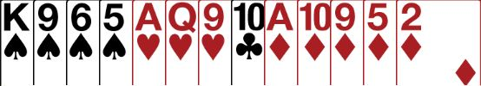

Balanced or Not?
No singleton or void
No more than 1 doubleton
No 5-card major

Slide 8

Balanced or Not?
No singleton or void
No more than 1 doubleton
No 5-card major

Slide 9
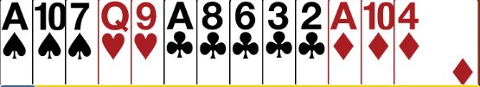
Balanced or Not?
No singleton or void
No more than 1 doubleton
No 5-card major

Slide 10

Balanced or Not?
No singleton or void
No more than 1 doubleton
No 5-card major

Slide 11
Balanced or Not ? What should you open ?
Open 1♠
Open 1NT

Slide 12
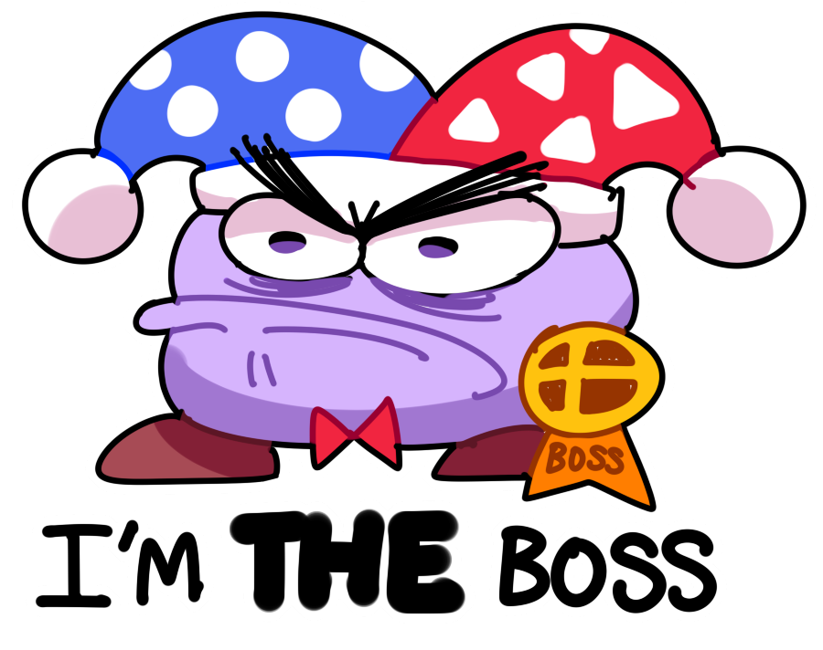
What does responder decide to do?
Have you got enough points
to bid or invite to game?
If so do you want to play in
NoTrumps or a suit?
Responder is the BOSS
There are ONLY 2 decisions to make

Slide 13
Responses to 1NT – Balanced Hand
0 – 10 points … no GAME possible
11 – 12 points … GAME is possible
13+ points … definitely in GAME
PASS
Bid 2NT
Bid 3NT
Add your points
to partner’s
KNOWN 12-14 points

Slide 14
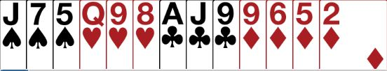
After 1NT what does responder do?
PASS
not enough for GAME
NoTrumps or a suit?
What level?

Slide 15

After 1NT what does responder do?
3NT
enough for GAME
NoTrumps or a suit?
What level?

Slide 16
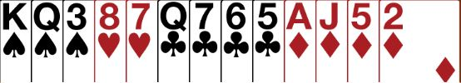
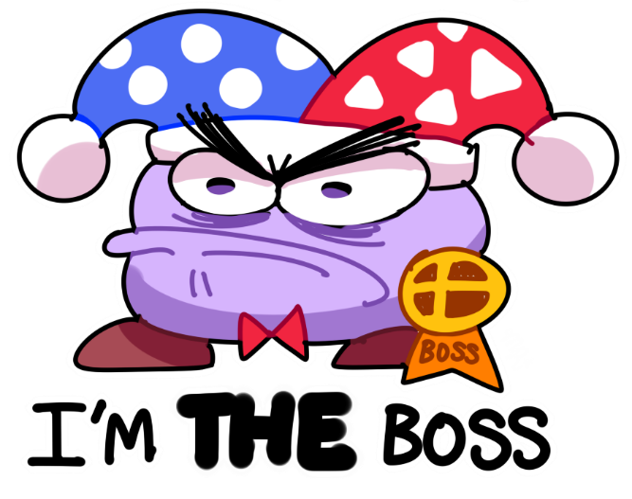
After 1NT what does responder do?
2NT
enough to invite to GAME
NoTrumps or a suit?
What level?

Slide 17

Responses to 1NT – Unbalanced Hand
0 – 10 points … no GAME possible
  Bid your card suit at the 2-level
  This is called a WEAK TAKEOUT
  Partner MUST then pass … YOU ARE THE BOSS
+
Add your points
to partner’s
KNOWN 12-14 points

Slide 18

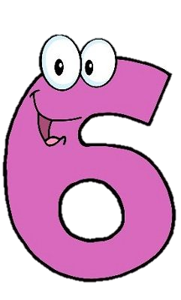
Responses to 1NT – Unbalanced Hand
12+ points … GAME Forcing
  Bid your card MAJOR at the 3-level
  (Opener MUST agree your suit or bid NoTrumps)
  Bid your card MAJOR at the 4-level - OR
  Bid your card MINOR at the 5-level

Slide 19
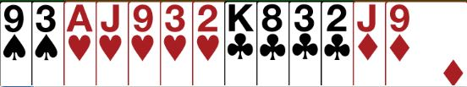
After 1NT what does responder do?
2♥
Not enough for GAME
Opener MUST pass

Slide 20
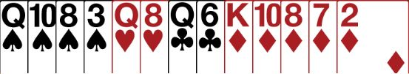
After 1NT what does responder do?
2♦
Not enough for GAME
OPENER must pass

Slide 21

After 1NT what does responder do?
4♠
Enough for GAME
and a known fit
Why is this fit guaranteed ?

Slide 22
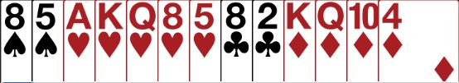
After 1NT what does responder do?
Bid 3♥… enough for GAME … need to check if there is a heart fit
Opener chooses 3NT or 4♥ (with a fit)

Slide 23
BEGINNERS’ LESSONS
any questions please ask
Teacher: your name
Telephone: your number
Email: your email

