Slide 1
BEGINNERS’ LESSONS
Welcome
Teacher: your name
Telephone: your phone
Email: your email

Slide 2
Lesson Nine
Pre-emptive Openings

Slide 3

Rules up until NOW
1NT opening – 12-14 points
1-suit openings – 12-19 points
BUT sometimes we have less then 12 points but still have some desire to get into the bidding … when????
You have a LONG suit of our own
i.e. 6 or more cards in the suit

Slide 4
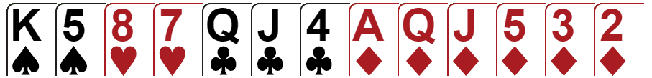
Normal Opening
Open 1♦
12 – 19 HCP

Slide 5
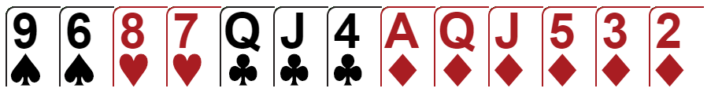
Can I open with this hand ?
6-10 HCP
BUT STILL a hand worth bidding on
Open 2♦

Slide 6

OPENING BIDS at the 2-level
(Pre-emptive bid or Weak 2)
2♦ ⇒ 6 – 10 points with a GOOD 6-card diamond suit
2♥ ⇒ 6 – 10 points with a GOOD 6-card heart suit
2♠ ⇒ 6 – 10 points with a GOOD 6-card spade suit
A GOOD suit is a suit with 2+ honours in the suit
Once you have opened with a pre-empt you will RARELY bid again … you have JUST one shot
These bids are DISRUPTIVE … we want to make it hard for the opposition to bid !

Slide 7


OPENING BIDS at the 2-level
(Pre-emptive bid or Weak 2)
2♦ ⇒ 6 – 10 points with a GOOD 6-card diamond suit
2♥ ⇒ 6 – 10 points with a GOOD 6-card heart suit
2♠ ⇒ 6 – 10 points with a GOOD 6-card spade suit
A GOOD suit is a suit with 2+ honours in the suit
Once you have opened with a pre-empt you will RARELY bid again … you have JUST one shot
The 2-level pre-empt is often referred to as a Weak 2
NOTE: 2♣ is not used as a weak bid
The 2♣ opener is a SPECIAL bid showing a
STRONG hand (more on that next lesson)
These bids are DISRUPTIVE … we want to make it hard for the opposition to bid !

Slide 8

Pre-emptive Opening at the 2-level
Open 2♠
6-10 points
GOOD 6-card suit

Slide 9

Pre-emptive Opening at the 2-level
PASS
6-10 points
BAD 6-card suit

Slide 10
Responses to 2-level Pre-emptive Opening
PASS ⇒ 0 – 13 points, 0-3 card support
3-level raise ⇒ 14-15 points, 2+ card support
GAME ⇒ 16+ points, 2+ card support
GAME ⇒ 0+ points, 4+ card support
NEW SUIT ⇒ 16+ points, 6+ card suit of own
2-level opening bids are DISRUPTIVE and are designed to make it hard for the opposition
Respond ONLY if you think there is a chance of reaching game or you have a 10+ card fit

Slide 11
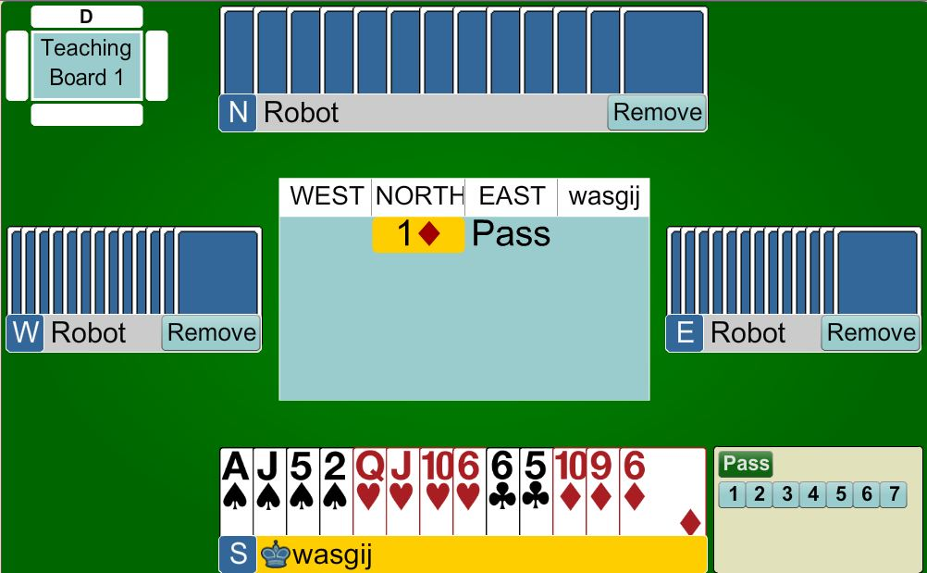
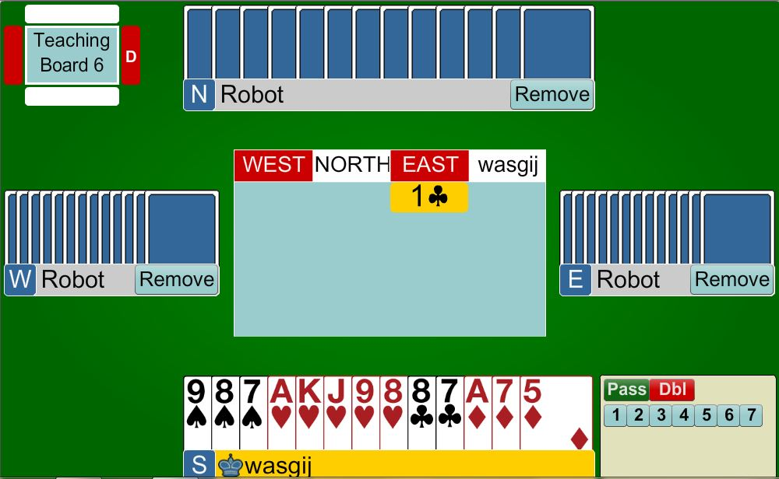

Pre-empts
Weak 2
PARTNER
2♦
Pass
Less than 14 points
Now very hard for West to bid !
HIM
HER
YOU

Slide 12
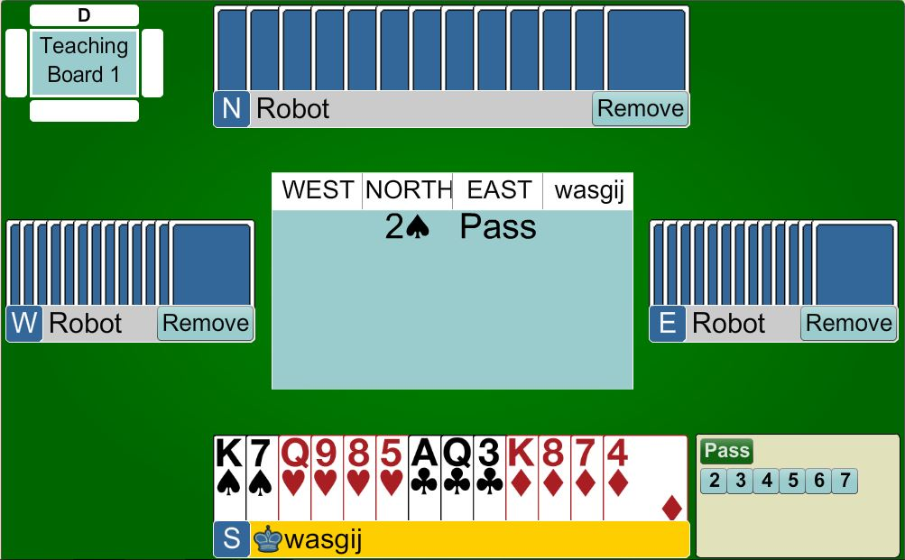
Pre-empts
Weak 2
PARTNER
3♠
14-15 points
We have a FIT
Invite partner to GAME
HIM
HER
YOU

Slide 13
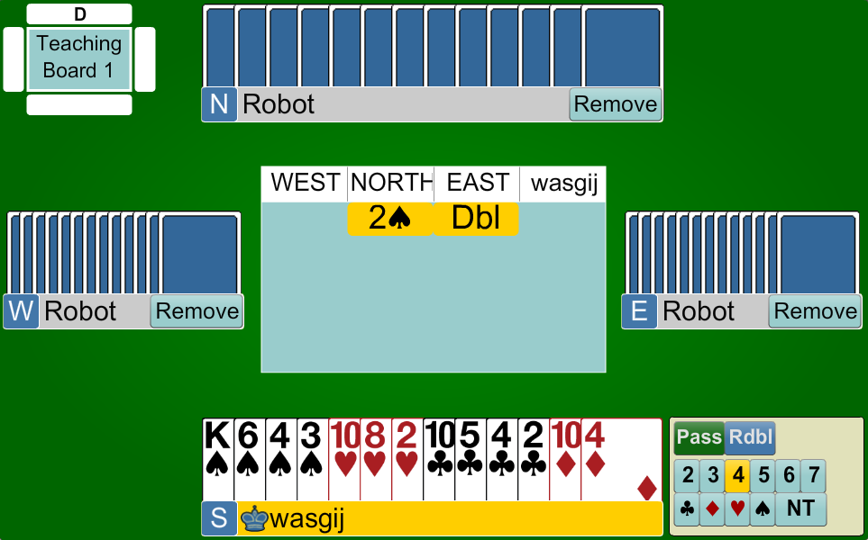
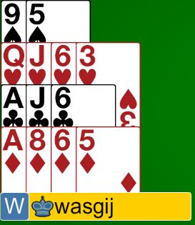
Pre-empts
Weak 2
What does West do?
PASS?
5 Hearts?
Double?
They have to GUESS
PARTNER
4♠
4♠
Put West to the guess
We have a 10-card FIT
Bid to GAME
16 points
2-card support … WE HAVE A FIT
Bid to GAME
HER
HIM
YOU

Slide 14
OPENING BIDS at the 3-level
(Pre-emptive bid)
3♣ ⇒ 6 – 10 points with a GOOD 7-card club suit
3♦ ⇒ 6 – 10 points with a GOOD 7-card diamond suit
3♥ ⇒ 6 – 10 points with a GOOD 7-card heart suit
3♠ ⇒ 6 – 10 points with a GOOD 7-card spade suit
A GOOD suit is a suit with 2+ honours in the suit
Once you have opened with a pre-empt you will RARELY bid again … you have JUST one shot
These bids are DISRUPTIVE … we want to make it hard for the opposition to bid !

Slide 15
Responses to 3-level Pre-emptive Opening
PASS ⇒ 0 – 14 points, 0-2 card support
GAME ⇒ 15+ points, 1+ card support
GAME ⇒ 0+ points, 3+ card support
NEW SUIT ⇒ 16+ points, 6+ card suit of own
3-level opening bids are DISRUPTIVE and are designed to make it hard for the opposition
Respond ONLY if you think there is a chance of reaching game or you have a 10+ card fit

Slide 16
OPENING BIDS at the 4-level
(Pre-emptive bid)
4♥ ⇒ 6 – 10 points with a GOOD 8-card heart suit
4♠ ⇒ 6 – 10 points with a GOOD 8-card spade suit
A GOOD suit is a suit with 2+ honours in the suit
You may also choose to open at the 4-level with
a good 8-card minor
These bids are DISRUPTIVE … we want to make it hard for the opposition

Slide 17

WHAT DO YOU DO WHEN THE OPPOSITION MAKES THESE WEAK BIDS?
The same rules apply for the
Takeout Double
… you show at least 3 cards in
the unbid suits and 12+ HCP
JUST be mindful that you may
need a slightly better point count
PASS
OVERCALL
No Trumps
DUNNO

Slide 18
WHAT DO YOU DO WHEN THE OPPOSITION MAKES THESE WEAK BIDS?
The same rules apply for overcalls
… you show a good 5+ suit with
at least two honours
… you need 12+ HCP (2 or 3-level)
The same rules apply for overcalling NT
… you show 16-18 HCP (may have more), balanced with a stopper
The same rules apply for a PASS

Slide 19
BEGINNERS’ LESSONS
any questions please ask
Teacher: your name
Telephone: your number
Email: your email

