Slide 1
BEGINNERS’ LESSONS
Welcome
Teacher: your name
Telephone: your number
Email: your email

Slide 2
Lesson Ten
Strong Opening Bids

Slide 3

Rules up until NOW
1NT opening – 12-14 points
1-level openings – 12-19 points
2-level openings – 6-10 points
3-level openings – 6-10 points
BUT sometimes we have
stronger hands (20+ points!)

Slide 4
What you know so far…
POINT COUNT | BIDDING
12 – 14 | Open 1NT
15 – 17 | Bid a suit then rebid 1NT
18 – 19 | Bid a suit then rebid 2NT
20 – 22 | ?
23+ | ?

Slide 5

Strong Opening Bids
There are TWO Strong Opening Bids
POINT COUNT | BIDDING
20 – 22
20+ (distributional) 23+ (balanced)
Open 2NT

Slide 6


STRONG OPENING BIDS – 2NT
20 – 22 points
Balanced hand

Slide 7

STRONG OPENING BIDS – 2NT
20 – 22 points
Balanced hand

Slide 8
RESPONSES TO 2NT (20-22 points)
PASS ⇒ 0-4 points, no GAME
3♣/♦ ⇒ 5+ card suit … forcing
3♥/♠ ⇒ 5-card suit … forcing
3NT ⇒ No 5-card major, balanced hand
4♥/♠ ⇒ 6-card suit
Opener now chooses 3NT or 4 of the major
Responses to 2NT openers are similar to 1NT openers … BUT there is no weak option now

Slide 9
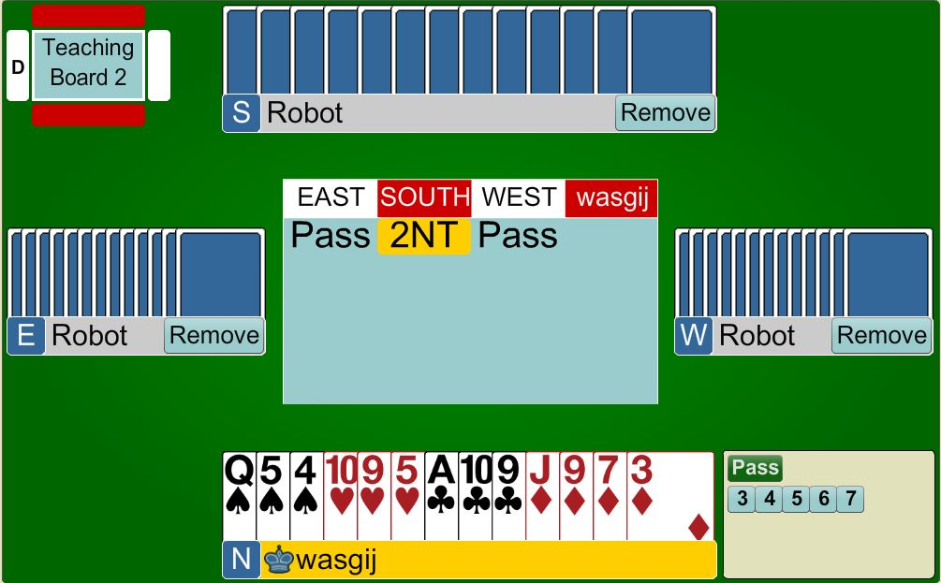


Responses to 2NT OPENER
PARTNER
3NT
5+ points
Balanced hand
HIM
HER
YOU

Slide 10

Responses to 2NT OPENER
PARTNER
3♥
5+ points
5-card heart suit
HIM
HER
YOU

Slide 11
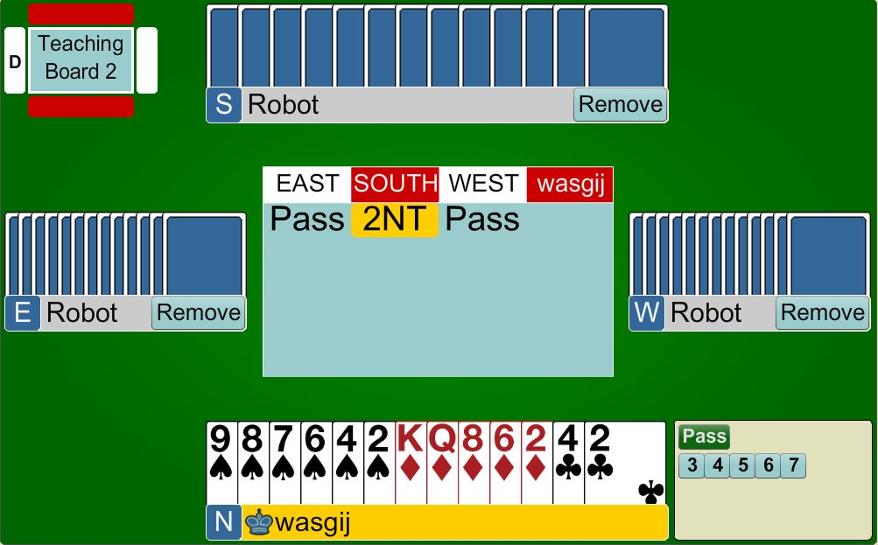
Responses to 2NT OPENER
PARTNER
4♠
5+ points
6-card spade suit
HIM
HER
YOU

Slide 12

Strong Opening Bids
There are TWO Strong Opening Bids
POINT COUNT | NOTRUMP STRUCTURE
20 – 22
20+ (distributional) 23+ (balanced)
Open 2NT
Open 2♣
(GAME FORCE)
2♣ is an ARTIFICIAL BID
Partner HAS to keep bidding until GAME is reached

Slide 13
Strong Opening Bids
There are TWO Strong Opening Bids
POINT COUNT | NOTRUMP STRUCTURE
20 – 22
20+ (distributional) 23+ (balanced)
Open 2NT
Open 2♣
Then rebid a suit
2♣ is an ARTIFICIAL BID
Partner HAS to keep bidding until GAME is reached

Slide 14
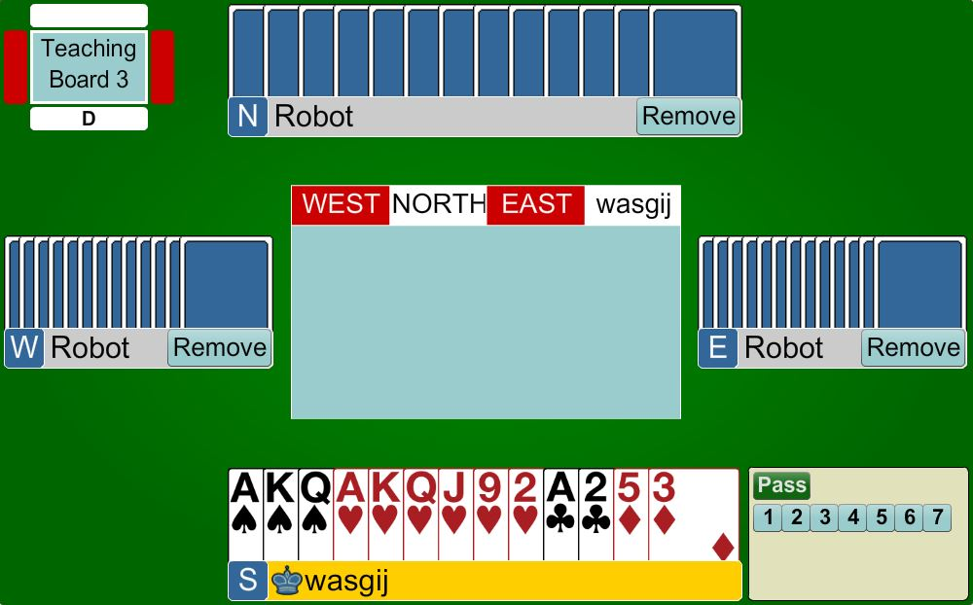
STRONG OPENING BIDS
Open 2♣
20+ points
Distributional hand
2♣ is an ARTIFICIAL BID
Partner HAS to keep bidding until GAME is reached

Slide 15
Strong Opening Bids
There are TWO Strong Opening Bids
POINT COUNT | NOTRUMP STRUCTURE
20 – 22
20+ (distributional) 23+ (balanced)
Open 2NT
Open 2♣
Then rebid 2NT or 3NT
2♣ is an ARTIFICIAL BID
Partner HAS to keep bidding until GAME is reached

Slide 16
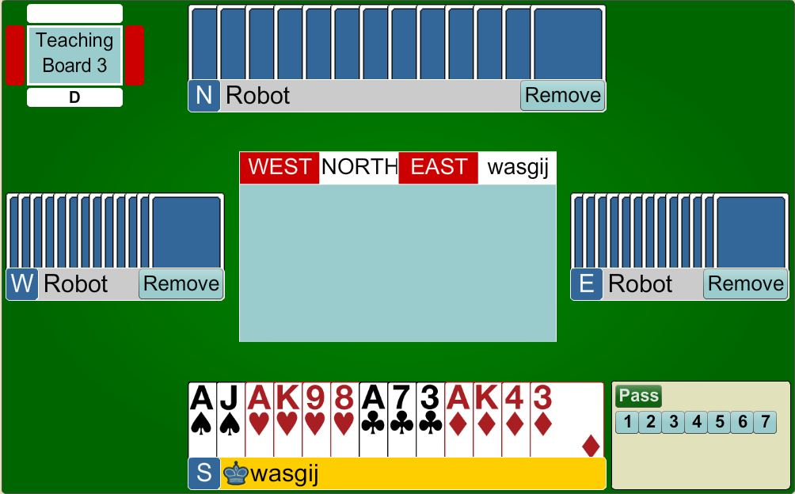
STRONG OPENING BIDS
Open 2♣
23+ points
Balanced hand
2♣ is an ARTIFICIAL BID
Partner HAS to keep bidding until GAME is reached

Slide 17
RESPONSES TO 2♣
2♦ ⇒ 0-7 points, any shape
2♥/♠ ⇒ 8+ points, 5+ card suit
2NT ⇒ 8+ points, balanced hand
3♣/♦ ⇒ 8+ points, 5+ card suit
The 2♦response is artificial … it has NOTHING to do with diamonds

Slide 18
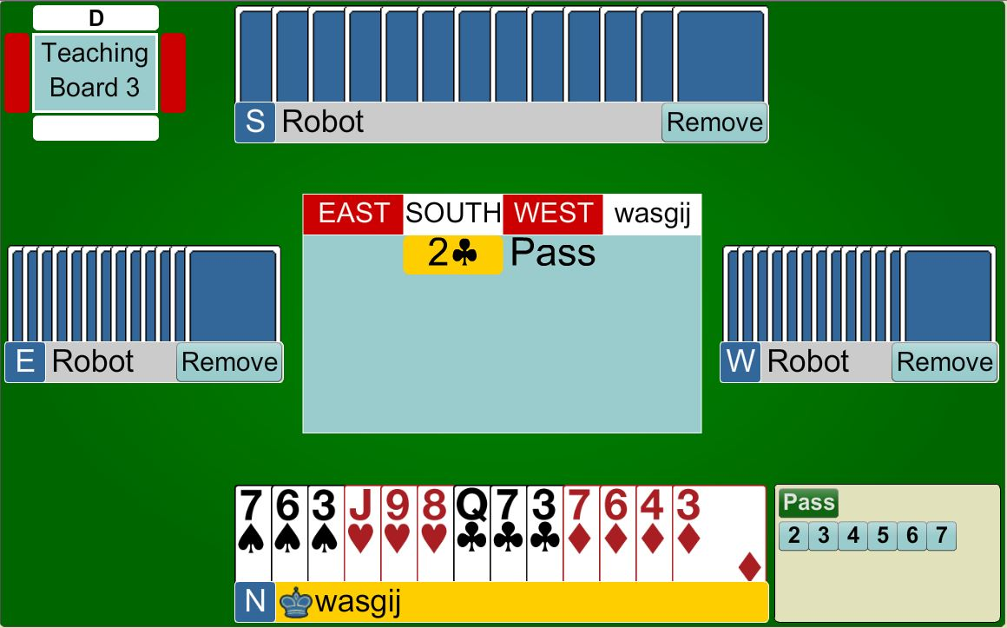
Responses to 2♣
GAME FORCE
PARTNER
2 ♦
0 – 7 points
2♦ is an
ARTIFICIAL BID
HIM
HER
YOU

Slide 19
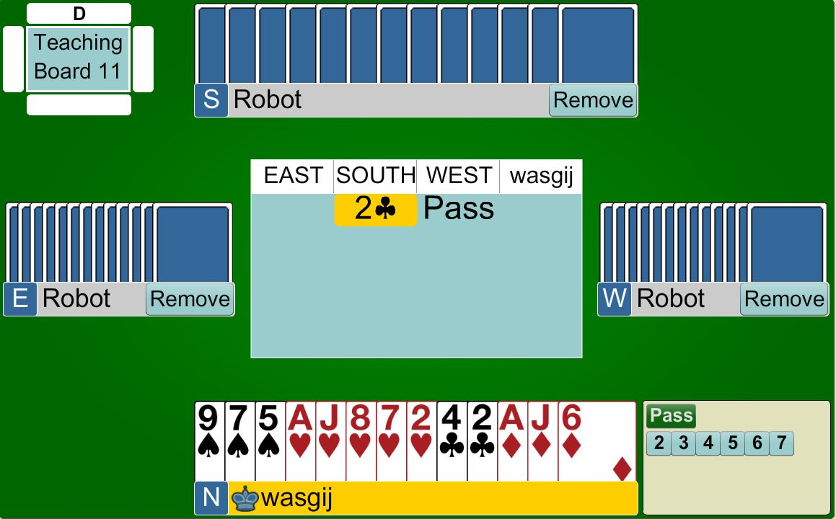
Responses to 2♣
GAME FORCE
PARTNER
2 ♥
8+ points
Shows 5+ hearts
HIM
HER
YOU

Slide 20

Responses to 2♣
GAME FORCE
PARTNER
2NT
8+ points
No 5-card suit
HIM
HER
YOU

Slide 21
OPENER’S REBIDS AFTER 2♣
IF partner bids 2♦ (weak)
  Bid your own 5-card + suit
  Bid 2NT (shows 23 or 24 points)
  Bid 3NT (shows 25+ points)
REMEMBER ... Partner HAS to keep bidding until GAME is reached

Slide 22
OPENER’S REBIDS AFTER 2♣
IF partner bids 2♥/2♠
  Agree the FIT with 3+ of the suit
  Bid 2NT (23 + points) – no fit
  Bid your own suit with 5-card + suit
REMEMBER ... Partner HAS to keep bidding until GAME is reached

Slide 23
OPENER’S REBIDS AFTER 2♣
IF partner bids 2NT
  Bid 3♥/3♠ with 5-card suit
  Bid 4♥/4♠ with 6+ card suit
  Bid 3NT with balanced hand
  Bid a minor if none of the above apply
REMEMBER ... Partner HAS to keep bidding until GAME is reached

Slide 24
OPENER’S REBIDS AFTER 2♣
IF partner bids 3♣/ 3♦
  Bid your own MAJOR suit with 5+ in suit
  Bid 3NT with balanced hand
  Raise the minor none of the above apply
REMEMBER ... Partner HAS to keep bidding until GAME is reached

Slide 25
STRONG OPENING BIDS
Open 2♣
Partner bids 2♦
Rebid 2♥
Showing 5+ hearts
2♣ is an ARTIFICIAL BID
Partner HAS to keep bidding until GAME is reached

Slide 26
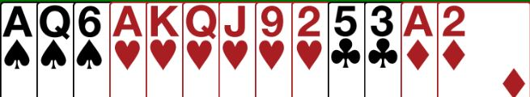
STRONG OPENING BIDS
Open 2♣
Partner bids 2NT
Rebid 4♥
Showing 6+ hearts ...
(Partner MUST have 2+ hearts)
2♣ is an ARTIFICIAL BID
Partner HAS to keep bidding until GAME is reached

Slide 27
STRONG OPENING BIDS
Open 2♣
Partner bids 2NT
Rebid 3NT
No 5+ major
2♣ is an ARTIFICIAL BID
Partner HAS to keep bidding until GAME is reached

Slide 28
STRONG OPENING BIDS
Open 2♣
Partner bids 2♥
Rebid 3♥
Showing a fit
2♣ is an ARTIFICIAL BID
Partner HAS to keep bidding until GAME is reached

Slide 29

BIDDING TO SLAM
A SLAM needs tricks
IF the partnership has 32+ points you MAY have the values for SLAM
You can find out how many aces partner has by bidding 4NT
You NEED to check that you are not missing
TWO aces

Slide 30
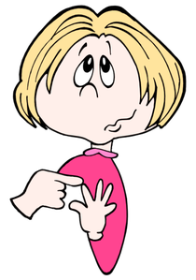
ASKING FOR ACES USING 4NT
5♣ ⇒ No Aces
5♦ ⇒ 1 Ace
5♥ ⇒ 2 Aces
5♠ ⇒ 3 Aces
Count on your fingers ?

Slide 31
ASKING FOR KINGS USING 5NT
After finding out the number of Aces with 4NT, you will either:
  Sign off at 5-level
  Bid Slam (6-level)
  If you have all the aces, bid 5NT asking for Kings
  (if you are looking for a Grand Slam!)

Slide 32
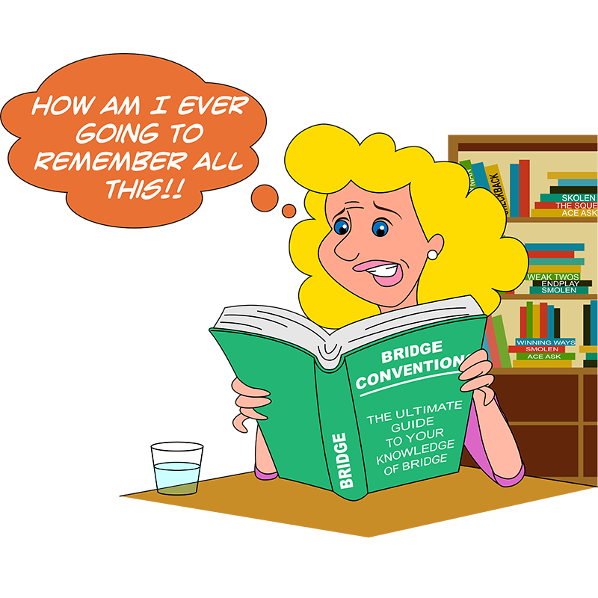
ASKING FOR KINGS USING 5NT
6♣ ⇒ No Kings
6♦ ⇒ 1 King
6♥ ⇒ 2 Kings
6♠ ⇒ 3 Kings
Count on your toes ?

Slide 33
You will discover there is still a lot to learn about the game, but there is no hurry ! Stick to the basics and master what you have learnt in these lessons before trying anything new.
Don’t let people tell you what to do.
Refer to your lesson notes to reinforce how you should bid and play the hands.
Advice from a Grand Master
Believe it or not, your bridge journey in just beginning !
Here is a great quote to help you on your way:
“It’s not usually the first mistake that gives you a
bad board, it is the second one. You often make
the second mistake because you are still focusing
on the first one. Don’t let one mistake cause another!”
- Robert S Todd
Notes:
Hide this slide if you do not want to use it

Slide 34

Have fun !
Notes:
Hide this slide if you do not want to use it

Slide 35
BEGINNERS’ LESSONS
any questions please ask
Teacher: your name
Telephone: your number
Email: your email

